Slide 1
Machine Learning: Music Genre Classification
Devon Hunter
♪

Slide 2
Overview
Project Description
Data Exploration and Preprocessing
Training the Models
Results

Slide 3
Project Description
The purpose of this project is to classify songs by genre using aural attributes
The scope is limited to 9 popular genres:
Blues
Classical
Country
Electronic
Folk
Hip-Hop
Jazz
Pop
Rock

Slide 4
Data Exploration and Preprocessing
The dataset was obtained from Kaggle.com and the data was generated by Spotify
There are 228,159 songs from 26 genres (though only 9 of the genres will be used)
There are 7 categorical variables and 11 numeric variables
There are no missing values

Slide 5
Data Exploration and Preprocessing
The variables are:
Genre
Artist Name
Track Name
Track ID
Popularity
Acousticness
Danceability
Duration_ms
Energy
Instrumentalness
Key
Liveness
Loudness
Mode
Speechiness
Tempo
Time_signature
Valence

Slide 6
Data Exploration and Preprocessing
Variables that are not tonal qualities of a song were removed (Artist name, Track name, Track ID, and Popularity)
Obscure genres and subgenres were removed; the genres listed in slide 3 remain.
The dataset was downsampled to improve training time
After downsampling, there are 1,733 observations for each of the 9 genres.
15,597 total observations

Slide 7
Data Exploration and Preprocessing
Heatmaps and chi-squared tests were used to evaluate the relationship between the categorical variables and the class variable
Side-by-side box plots and ANOVA tests were used to evaluate the relationship between the numeric variables and the class variable
For every variable, the chi-squared tests and ANOVA tests indicated a relationship with the class variable
The visualizations and test results are shown on the following slides

Slide 8
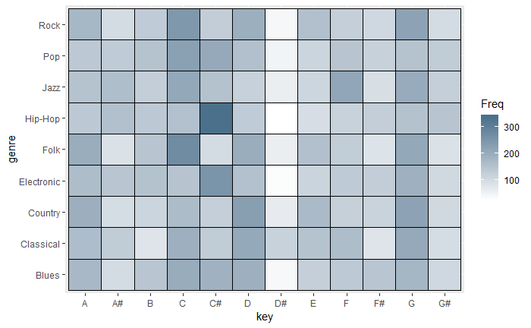
Data Exploration and Preprocessing Key and Genre
Some genres tend to prefer certain keys
Most noticeably, many Hip-Hop songs are in the key of C#
Pearson's Chi-squared test
data: key.table
X-squared = 769.15, df = 88, p-value < 2.2e-16

Slide 9
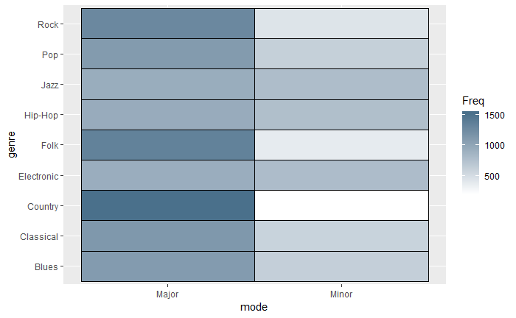
Data Exploration and Preprocessing Mode and Genre
Some genres use minor modes more frequently than others
Pearson's Chi-squared test
data: mode.table
X-squared = 846.87, df = 8, p-value < 2.2e-16

Slide 10
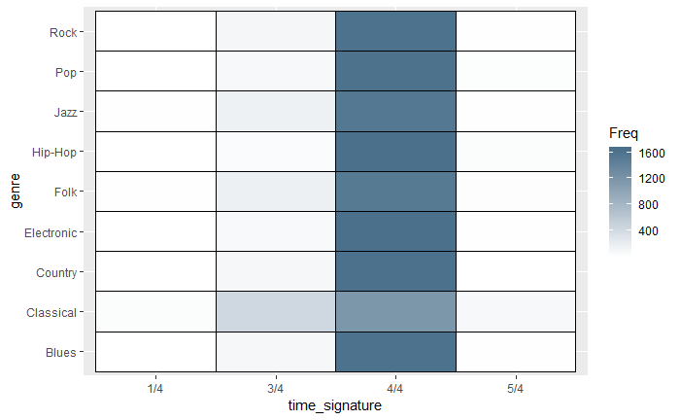
Data Exploration and Preprocessing Time Signature and Genre
Only a few genres use time signatures other than 4/4
Most songs are in 4/4
Pearson's Chi-squared test
data: timesig.table
X-squared = 1125.1, df = 24, p-value < 2.2e-16

Slide 11
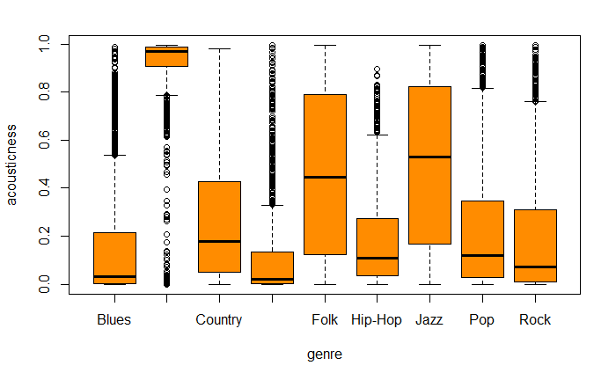
Data Exploration and Preprocessing Acousticness and Genre
One-way analysis of means (not assuming equal variances)
data: acousticness and genre
F = 1560.2, num df = 8.0, denom df = 6481.8, p-value < 2.2e-16

Slide 12
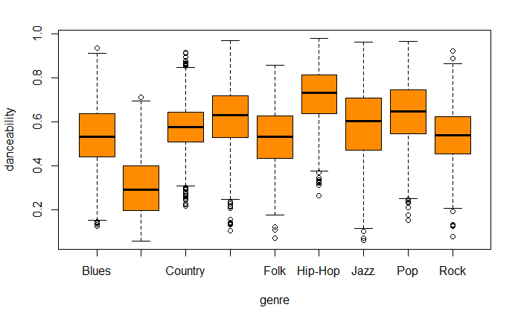
Data Exploration and Preprocessing Danceability and Genre
One-way analysis of means (not assuming equal variances)
data: danceability and genre
F = 1245.5, num df = 8.0, denom df = 6489.6, p-value < 2.2e-16

Slide 13
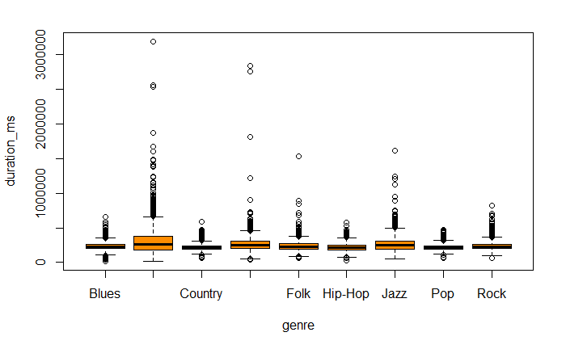
Data Exploration and Preprocessing Duration and Genre
One-way analysis of means (not assuming equal variances)
data: duration_ms and genre
F = 104.56, num df = 8.0, denom df = 6444.9, p-value < 2.2e-16

Slide 14
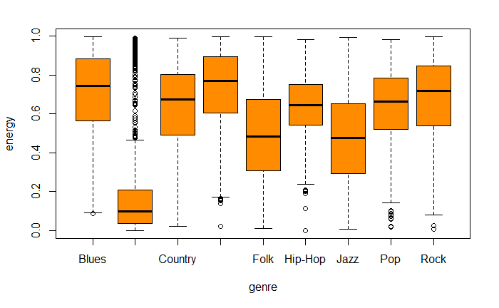
Data Exploration and Preprocessing Energy and Genre
One-way analysis of means (not assuming equal variances)
data: energy and genre
F = 1062.1, num df = 8.0, denom df = 6485.4, p-value < 2.2e-16

Slide 15
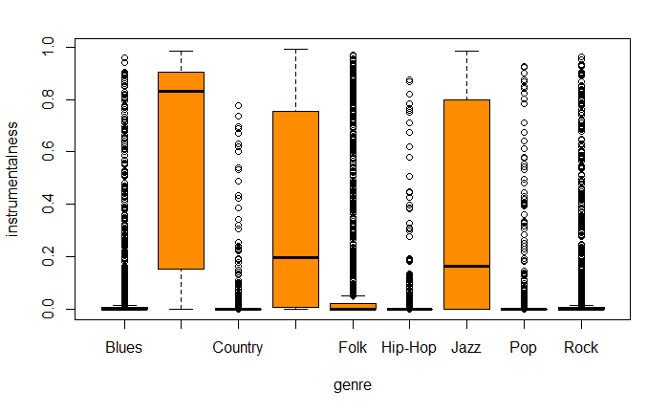
Data Exploration and Preprocessing Instrumentalness and Genre
One-way analysis of means (not assuming equal variances)
data: instrumentalness and genre
F = 905.37, num df = 8.0, denom df = 6357.9, p-value < 2.2e-16

Slide 16
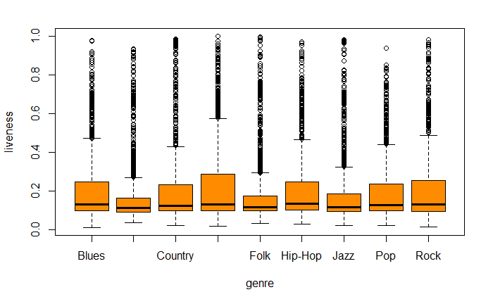
Data Exploration and Preprocessing Liveness and Genre
One-way analysis of means (not assuming equal variances)
data: liveness and genre
F = 14.752, num df = 8.0, denom df = 6493.4, p-value < 2.2e-16

Slide 17
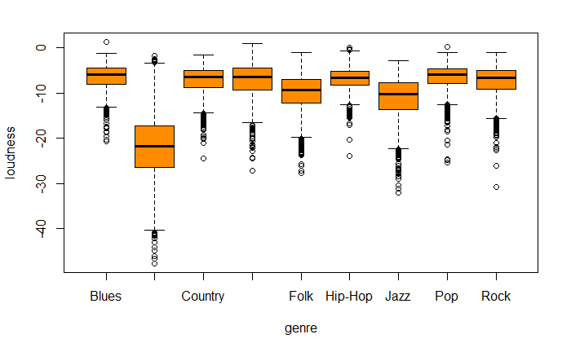
Data Exploration and Preprocessing Loudness And Genre
One-way analysis of means (not assuming equal variances)
data: loudness and genre
F = 984.83, num df = 8.0, denom df = 6470.1, p-value < 2.2e-16

Slide 18
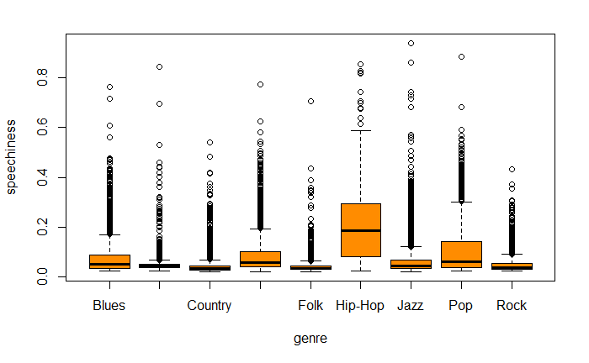
Data Exploration and Preprocessing Speechiness and Genre
One-way analysis of means (not assuming equal variances)
data: speechiness and genre
F = 411.04, num df = 8.0, denom df = 6432.7, p-value < 2.2e-16

Slide 19
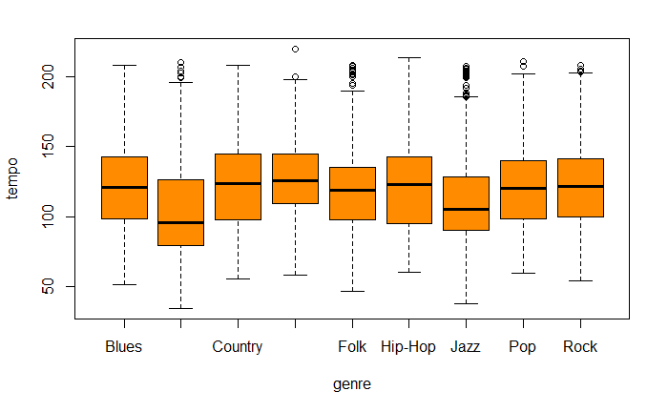
Data Exploration and Preprocessing Tempo and Genre
One-way analysis of means (not assuming equal variances)
data: tempo and genre
F = 95.534, num df = 8.0, denom df = 6494, p-value < 2.2e-16

Slide 20
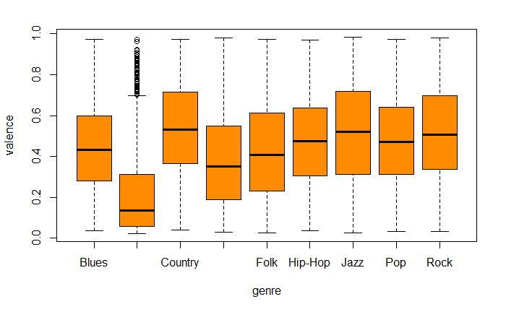
Data Exploration and Preprocessing Valence And Genre
One-way analysis of means (not assuming equal variances)
data: valence and genre
F = 381.84, num df = 8.0, denom df = 6493.4, p-value < 2.2e-16

Slide 21
Data Exploration and Preprocessing
The dataset was partitioned into train and test sets (90% train, 10% test)
The train and test sets were duplicated, converted to all numeric, and normalized using min-max normalization so all variable values were between 0 and 1
The numeric dataset was used for KNN, SVM, and neural networks
To train the neural networks with multiple class values, the class variable was one-hot encoded using Keras’ to_categorical() function
This was done just before training the neural networks
Neural networks were trained last so the class labels did not need to be decoded

Slide 22
Training the Models
10-fold cross-validation and the caret package were used to train and tune the models (except the neural network)
6 classifiers were trained and tuned:
KNN
SVM Linear
SVM Radial
Random Forest
GBM
Neural Network

Slide 23
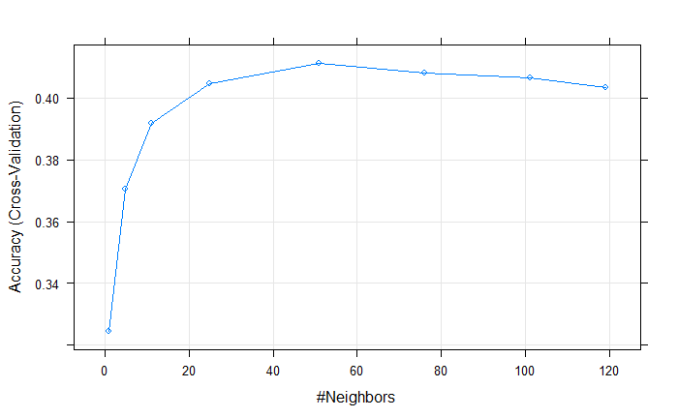
Training the Models: KNN
A tune grid was used with values between 1 and the square root of the number of observations in the training set
OOS Accuracy: 42.4%
t.grid <- expand.grid(k = c(1, 5, 11, 25, 51, 76, 101, 119))
knn.model <- train(genre ~ ., data = music.train.num,
trControl = trainControl(method = "cv", number = 10),
tuneGrid = t.grid,
method = "knn")

Slide 24
Training the Models: SVM Linear
A tune grid was used with values between 0.5 and 5
Changes to the hyper parameter didn’t make much difference in performance
OOS Accuracy: 45.15%
t.grid <- expand.grid(C = c(.5, 1, 3, 5))
svm.lin.model <- train(genre ~ ., data = music.train.num,
trControl = trainControl(method = "cv", number = 10),
tuneGrid = t.grid,
method = "svmLinear")
Resampling results across tuning parameters:
C Accuracy Kappa
0.5 0.4481481 0.3791667
1.0 0.4481481 0.3791667
3.0 0.4481481 0.3791667
5.0 0.4482194 0.3792468

Slide 25
Training the Models: SVM Radial
This model took the longest to train
Using a tune grid was slow and impractical
The hyperparameters were autotuned by caret
OOS Accuracy: 46.76%
svm.rad.model <- train(genre ~ ., data = music.train.num,
trControl = trainControl(method = "cv", number = 10),
method = "svmRadial")
Resampling results across tuning parameters:
C Accuracy Kappa
0.25 0.4553419 0.3872596
0.50 0.4606838 0.3932692
1.00 0.4664530 0.3997596
Tuning parameter ‘sigma’ was held constant at a value of 0.06630039
Accuracy was used to select the optimal model using the largest value.
The final values used for the model were sigma = 0.06630039 and C = 1.

Slide 26
Training the Models: Random Forest
A tune grid was used with mtry values between 1 and the number of features in the dataset
Instrumentalness, speechiness, and danceability were the three most important variables
OOS Accuracy: 47.53%
t.grid <- expand.grid(mtry = c(1, 3, 6, 8, 11, 13))
rf.model <- train(genre ~ ., data = music.train.num,
trControl = trainControl(method = "cv", number = 10),
method = “rf")
Resampling results across tuning parameters:
mtry Accuracy Kappa
1 0.3706553 0.2919872
3 0.4762821 0.4108173
6 0.4760684 0.4105769
8 0.4720798 0.4060897
11 0.4718661 0.4058494
13 0.4708689 0.4047276
Accuracy was used to select the optimal model using the largest value.
The final value used for the model was mtry = 3.

Slide 27
Training the Models: GBM
GBM took almost as long as SVM radial to tune
The model was autotuned with caret
OOS Accuracy: 49.45%
gbm.model <- train(genre ~ ., data = music.train.num,
trControl = trainControl(method = "cv", number = 10),
method = “gbm")
Resampling results across tuning parameters:
interaction.depth n.trees Accuracy Kappa
1 50 0.4476496 0.3786058
1 100 0.4650285 0.3981571
1 150 0.4717949 0.4057692
2 50 0.4686610 0.4022436
2 100 0.4782051 0.4129808
2 150 0.4819801 0.4172276
3 50 0.4730769 0.4072115
3 100 0.4811254 0.4162660
3 150 0.4845442 0.4201122
Tuning parameter 'shrinkage' was held constant at a value of 0.1
Tuning parameter 'n.minobsinnode' was held constant at a value of 10
Accuracy was used to select the optimal model using the largest value.
The final values used for the model were n.trees = 150,
interaction.depth = 3, shrinkage = 0.1 and n.minobsinnode = 10.

Slide 28
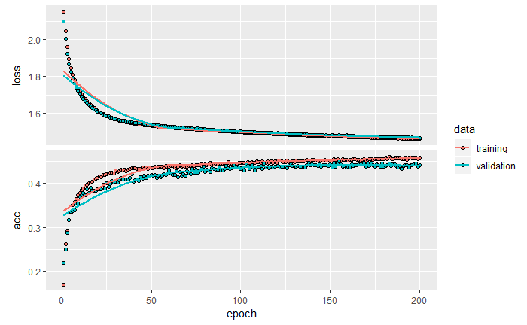
Training the Models: Neural Network
The neural networks were tuned manually using different values for the mini-batch size, number of layers, and number of neurons
Softmax activation function and categorical_crossentropy loss function were used
Class labels were one-hot encoded
OOS Accuracy: 45.99%
model <- keras_model_sequential() %>%
layer_dense(units = 40, activation = "relu", input_shape = dim(music.train.nn)[2]) %>%
layer_dense(units = 9, activation = "softmax")
model %>% compile(loss = "categorical_crossentropy", optimizer = "sgd", metrics = "accuracy")
history <- model %>% fit(music.train.nn, music.train.labels,
batch_size = 32, epochs = 200,
verbose = 0,
validation_data = list(music.validation.nn, music.validation.labels))

Slide 29
Results
GBM performed the best
Classification accuracy and AUC are not great
Models have trouble classifying pop and rock songs
More descriptive features or fewer class labels would improve accuracy
Model | Accuracy | AUC
KNN | 42.3% | 0.64
SVM Linear | 45.1% | 0.651
SVM Radial | 46.7% | 0.651
Random Forest | 47.5% | 0.668
GBM | 49.4% | 0.657
Neural Network | 45.9% | 0.653

